Slide 1
BLU
FACTORS INFLUENCING CONSUMERS’ SATISFACTION
Using predictive analysis to understand business

Slide 2
BLU
01
Executive Summary
Management

Slide 3
Project Setup
Leader in growth and new customers share
Last among competitors in customer retention
Need to understand customer behaviour
Outperforms peers
Underperforms in repeat business
Through customer satisfaction survey and review score

Slide 4
Main conclusions and proposed actions
Main Conclusions:
High delay and shipping cost need addressed
Some categories need to be investigated to identify the dissatisfactory products
Proposed actions:
Consider a change in shipping company
Split categories to identify products that are a source of bad review
Improve/implement a recommendation system

Slide 5
BLU
02
Business Section
Relevant insights & Business actions

Slide 6
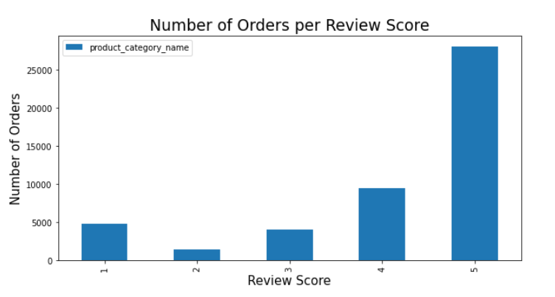
Data Overview
Review score | Nbr of orders | Share
1 | 4820 | 10%
2 | 1509 | 3%
3 | 4026 | 8%
4 | 9503 | 20%
5 | 28138 | 59%
More than 3 orders out of 4 review score is 4 or 5
Third highest review score is 1
47996 total orders

Slide 7
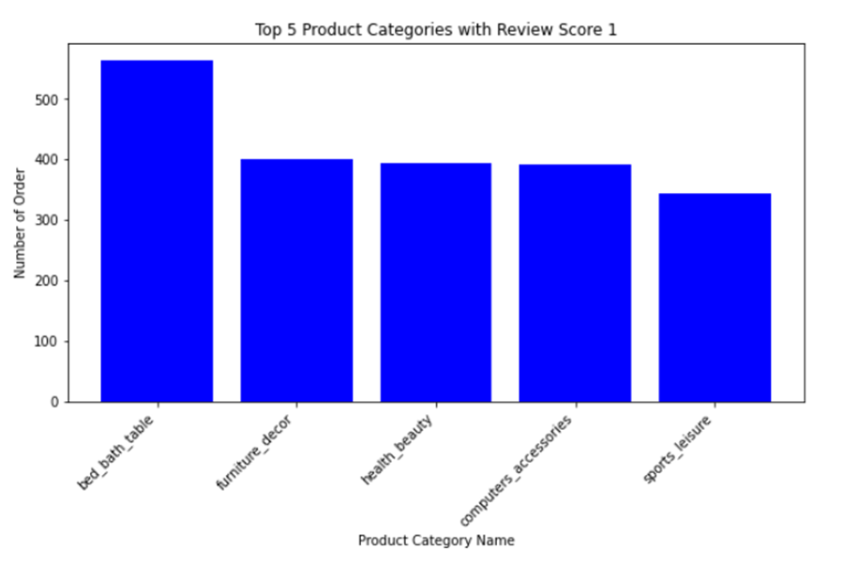
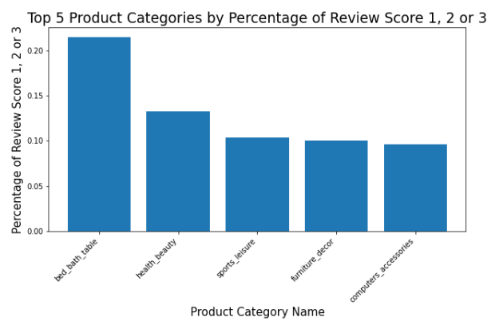
Product Category Overview
Bed_bath_table is by far the category with the highest number of negative reviews
Almost 1 order out of 5 including a product from these categories end up receiving a negative review
These 5 categories are receiving the highest number of bad reviews overall

Slide 8
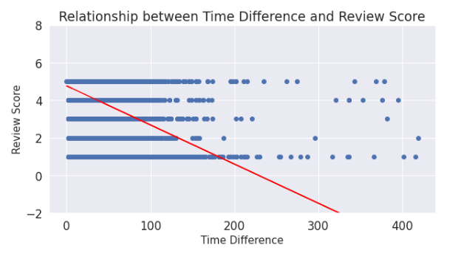
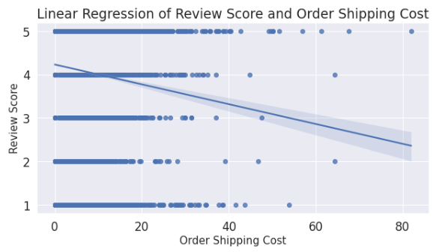
Key factors influencing review score
Clear negative relationship between long time difference and review score
Clear negative relationship between high order shipping cost and review score

Slide 9
Business actions
Identify the bottlenecks and consider a change of shipping company
Consider splitting the categories to further identify products which are the cause of the bad reviews
Implement/improve the recommendation system
Correct delivery time delay and high shipping cost
Investigate the product categories with the lowest review score
Incentivize existing customers

Slide 10
BLU
03
Data Strategy
Technical Summary

Slide 11
Data Processing
ORDERS
ORDER_PAYMENTS
ORDER_ITEMS
PRODUCTS
ORDER_REVIEWS
RAW DATA
BASETABLE
GBTree
Data Exploration
Data Cleaning
Basetable
Feature Engineering
Feature selection
ML Models comparison & selection
Model Tuning
Results

Slide 12
Feature Selection
TIMEDIFF:
Approval_time_difference_with_purchase
Delivered_carrier_time_difference_with_purchase
Delivered_customer_time_difference_with_purchase
Estimate_delivery_time_difference_with_purchase
delivery_time_difference_with_estimated
PARCEL INFORMATION:
Approx_parcel_weight
Approx_parcel_height_cm
Approx_parcel_width_cm
WEBSITE INFORMATION:
Min_nb_photos
Min_product_name_lenght
Maxproduct_name_lenght
Mean_product_name_lenght
min_product_description_lenght
PAYMENT/PRICE INFORMATION:
Payment_installments
Total_payment_value
Credit_card_total_payment_value
Mobile_total_payment_value
Payment_installment_ratio
Order_shipping_cost
CONSUMER INFORMATION:
Order_count
loyalty
Order_number
PEARSON’S R (numerical variables):
Measure of the linear relationship between 2 continuous variables
Ranges from -1 to 1
(n (∑xy)- (∑x)(∑y))
(√ [n ∑x2-(∑x)2][n ∑y2– (∑y)2 )
r =

Slide 13
Basetable & models
BASETABLE:
Row: 47996
Granularity: Order_id
Order_review :
0 : 3★ or less
1 : 4★ or 5★
Features:
36 before feature selection
24 after feature selection
DTree has been trained successfully
DTree: AUC = 0.6377006345054238
DTree: Accuracy = 0.778799841355601
LR has been trained successfully
LR: AUC = 0.690124085610881
LR: Accuracy = 0.766480978142894
RForest has been trained successfully
RForest: AUC = 0.6602725762609484
RForest: Accuracy = 0.7653909968266195
GBT has been trained successfully
GBT: AUC = 0.6882037404849782
GBT: Accuracy = 0.7807755556741823

Slide 14
0.69
78.55%
Binary Classification Results
AUC
Accuracy

Slide 15
0.48
61%
Multiclass Classification Results
Challenge and an opportunity towards improvement
F1 Score
Accuracy

Slide 16
BLU
Thanks !
Do you have any question ?
Alice Degonzague
Cyril Kancel
Nandini Gantayat

